Slide 1
STUDENT EXPENSE TRACK MANAGEMENT SYSTEM Rajvee Shah Aditya Kini

Slide 2
Summary

Slide 3
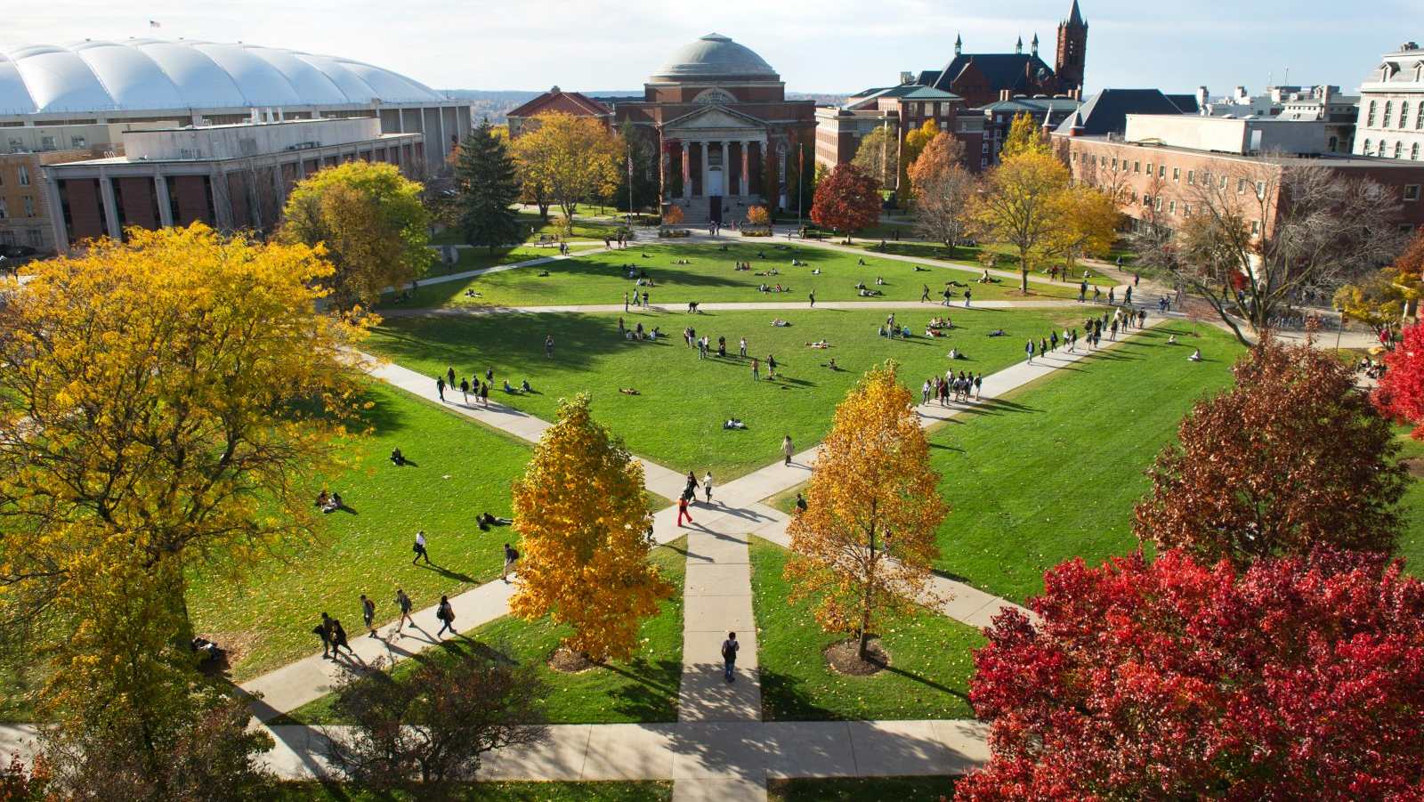
Syracuse University Bookstore

Slide 4
Current Scenario
Students are unable to track the expenditure made in the campus during an academic year
Students are unable to compare and choose products from which bookstore before making a purchase
Students are unable to view their purchase history at one place
Absence of Single platform for Parents to view the child expenses

Slide 5

WHY STUDENT EXPENSE TRACKING SYSTEM?

Slide 6
System Users
Student
PARENT

Slide 7
Entity Relationship Diagram

Slide 8

Major Data Questions

Slide 9
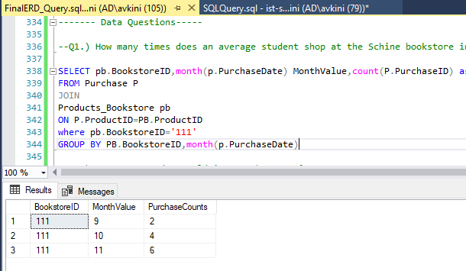
How many times does an average student shop at the Schine bookstore in each month?
SELECT pb.BookstoreID,month(p.PurchaseDate) MonthValue,count(P.PurchaseID) as PurchaseCounts
FROM Purchase P
JOIN
Products_Bookstore pb
ON P.ProductID=PB.ProductID
where pb.BookstoreID='111'
GROUP BY PB.BookstoreID,month(p.PurchaseDate)

Slide 10
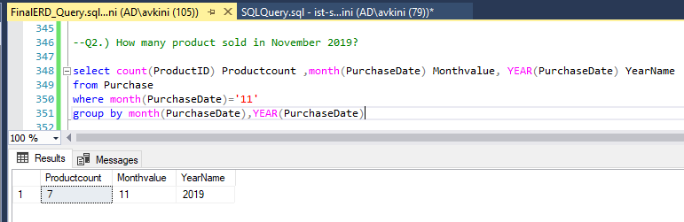
How many product sold in November 2019?
select count(ProductID) Productcount ,month(PurchaseDate) Monthvalue, YEAR(PurchaseDate) YearName
from Purchase
where month(PurchaseDate)='11'
group by month(PurchaseDate),YEAR(PurchaseDate)

Slide 11
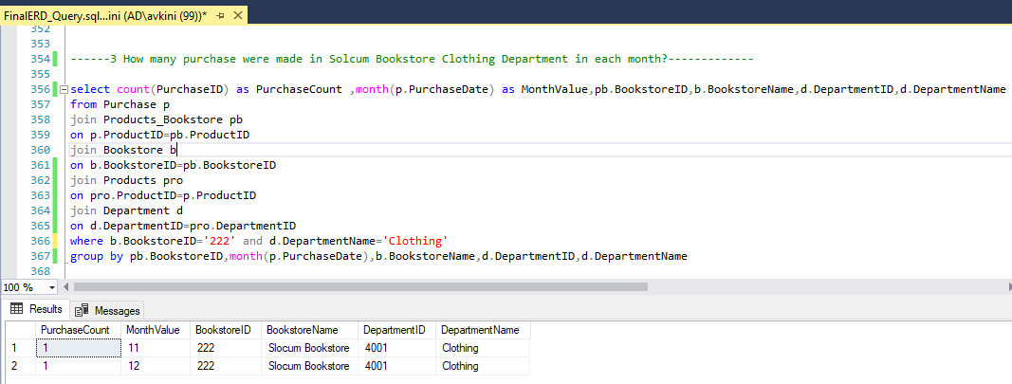
How many purchase were made in Solcum Bookstore Clothing Department in each month?
select count(PurchaseID) as PurchaseCount ,month(p.PurchaseDate) as MonthValue,pb.BookstoreID,b.BookstoreName,d.DepartmentID,d.DepartmentName
from Purchase p
join Products_Bookstore pb
on p.ProductID=pb.ProductID
join Bookstore b
on b.BookstoreID=pb.BookstoreID
join Products pro
on pro.ProductID=p.ProductID
join Department d
on d.DepartmentID=pro.DepartmentID
where b.BookstoreID='222' and d.DepartmentName='Clothing'
group by pb.BookstoreID,month(p.PurchaseDate),b.BookstoreName,d.DepartmentID,d.DepartmentName

Slide 12
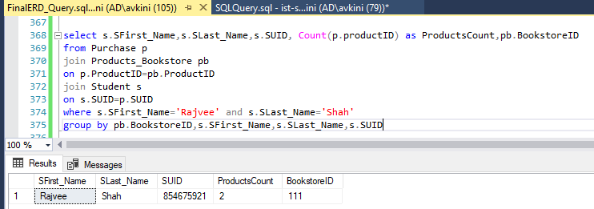
How many products are purchased by Rajvee Shah from each bookstore?
select s.SFirst_Name,s.SLast_Name,s.SUID, Count(p.productID) as ProductsCount,pb.BookstoreID
from Purchase p
join Products_Bookstore pb
on p.ProductID=pb.ProductID
join Student s
on s.SUID=p.SUID
where s.SFirst_Name='Rajvee' and s.SLast_Name='Shah'
group by pb.BookstoreID,s.SFirst_Name,s.SLast_Name,s.SUID

Slide 13
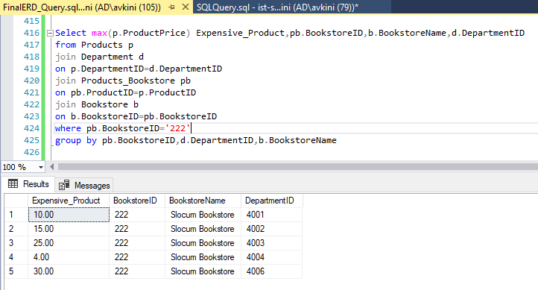
Which are the expensive product prices in Slocum Bookstore each department?
Select max(p.ProductPrice) Expensive_Product,pb.BookstoreID,b.BookstoreName,d.DepartmentID
from Products p
join Department d
on p.DepartmentID=d.DepartmentID
join Products_Bookstore pb
on pb.ProductID=p.ProductID
join Bookstore b
on b.BookstoreID=pb.BookstoreID
where pb.BookstoreID='222'
group by pb.BookstoreID,d.DepartmentID,b.BookstoreName

Slide 14
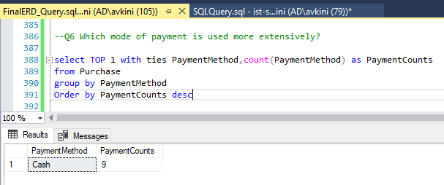
Which mode of payment is used more extensively?
select TOP 1 with ties PaymentMethod,count(PaymentMethod) as PaymentCounts
from Purchase
group by PaymentMethod
Order by PaymentCounts desc

Slide 15
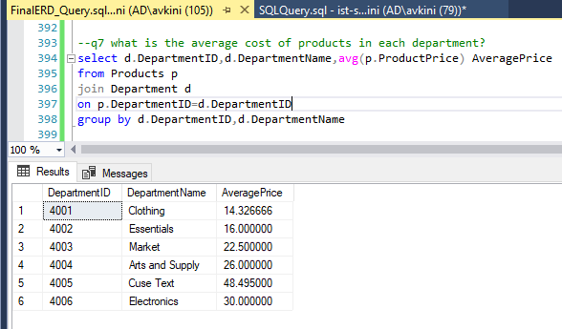
What is the average cost of products in each department?
select d.DepartmentID,d.DepartmentName,avg(p.ProductPrice) AveragePrice
from Products p
join Department d
on p.DepartmentID=d.DepartmentID
group by d.DepartmentID,d.DepartmentName

Slide 16
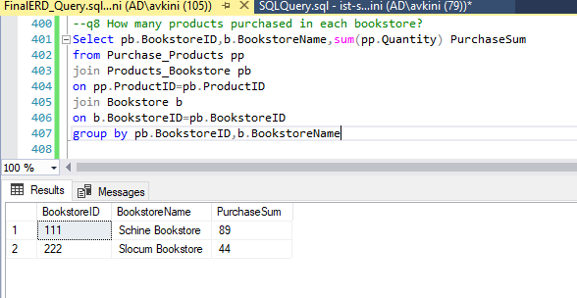
How many products purchased in each bookstore?
Select pb.BookstoreID,b.BookstoreName,sum(pp.Quantity) PurchaseSum
from Purchase_Products pp
join Products_Bookstore pb
on pp.ProductID=pb.ProductID
join Bookstore b
on b.BookstoreID=pb.BookstoreID
group by pb.BookstoreID,b.BookstoreName

Slide 17
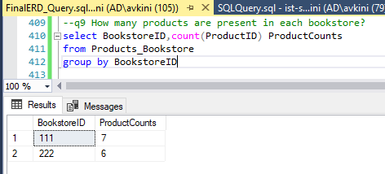
How many products are present in each bookstore?
select BookstoreID,count(ProductID) ProductCounts
from Products_Bookstore
group by BookstoreID

Slide 18
Project Demo

